Slide 1
Two Steps Authentication System & RSA Algorithm
By: Hassan El Krytly and Mirsa Casas

Slide 2
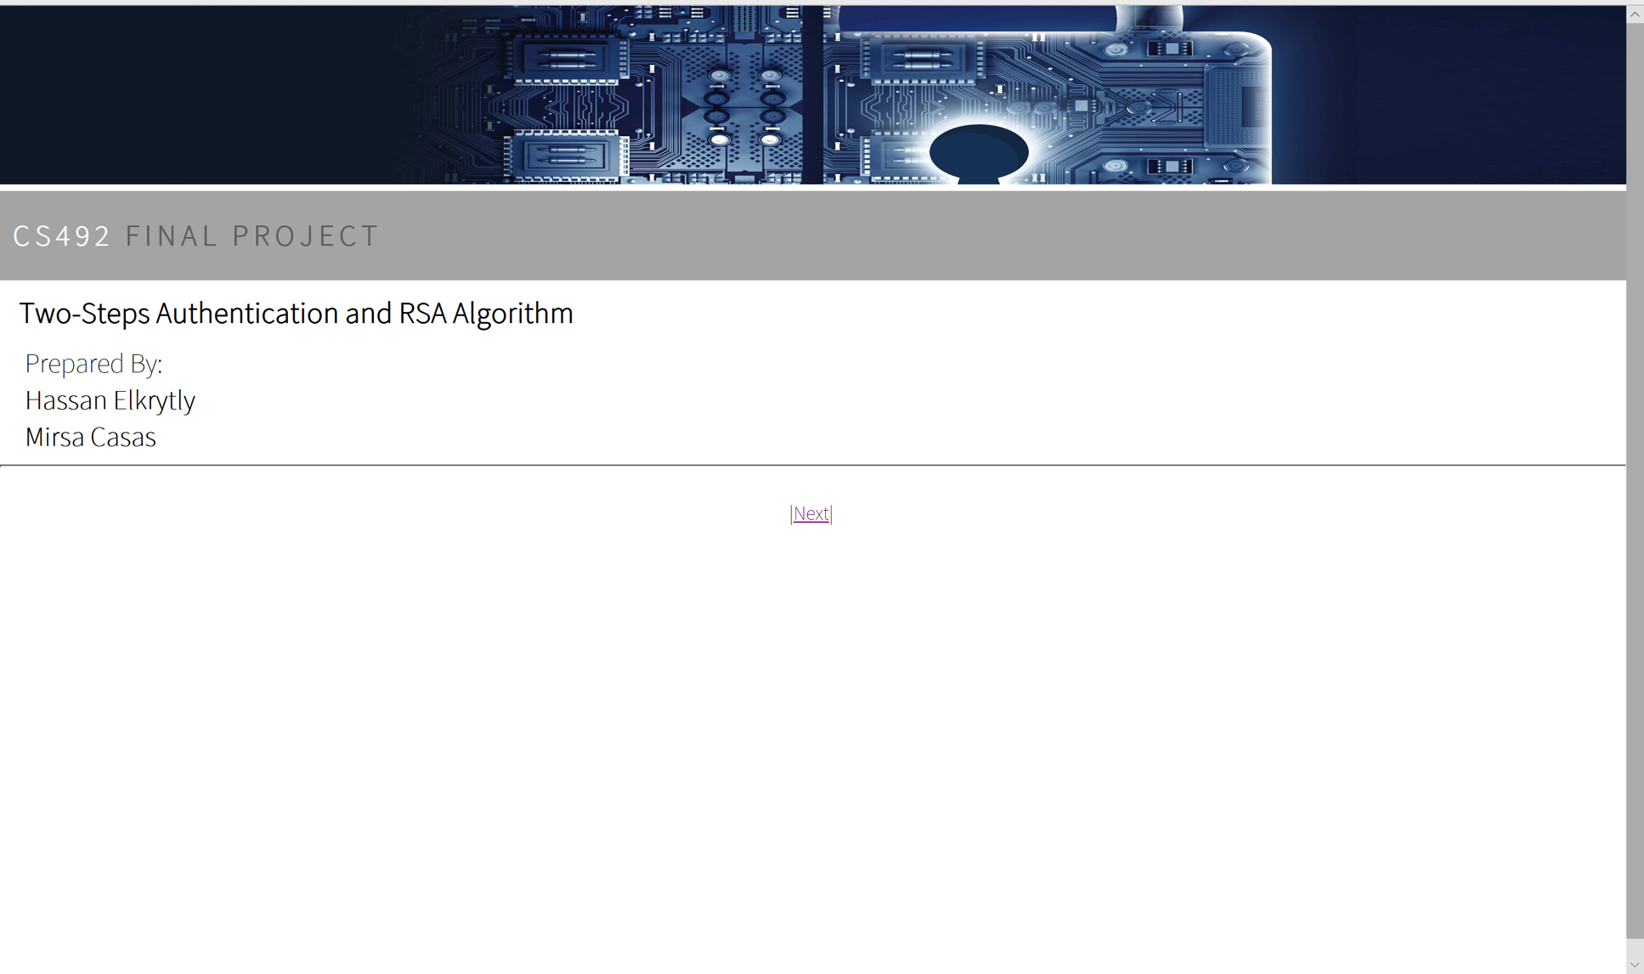
Welcome Page (title.html)
In this page, the tittle of our final project and our names are shown.

Slide 3
Introduction
Our Final Project is a sample application that demonstrates two major security concepts. The first one is Two Steps Authentication to authenticate the user of the application, and the second one is the use of RSA Algorithm.

Slide 4
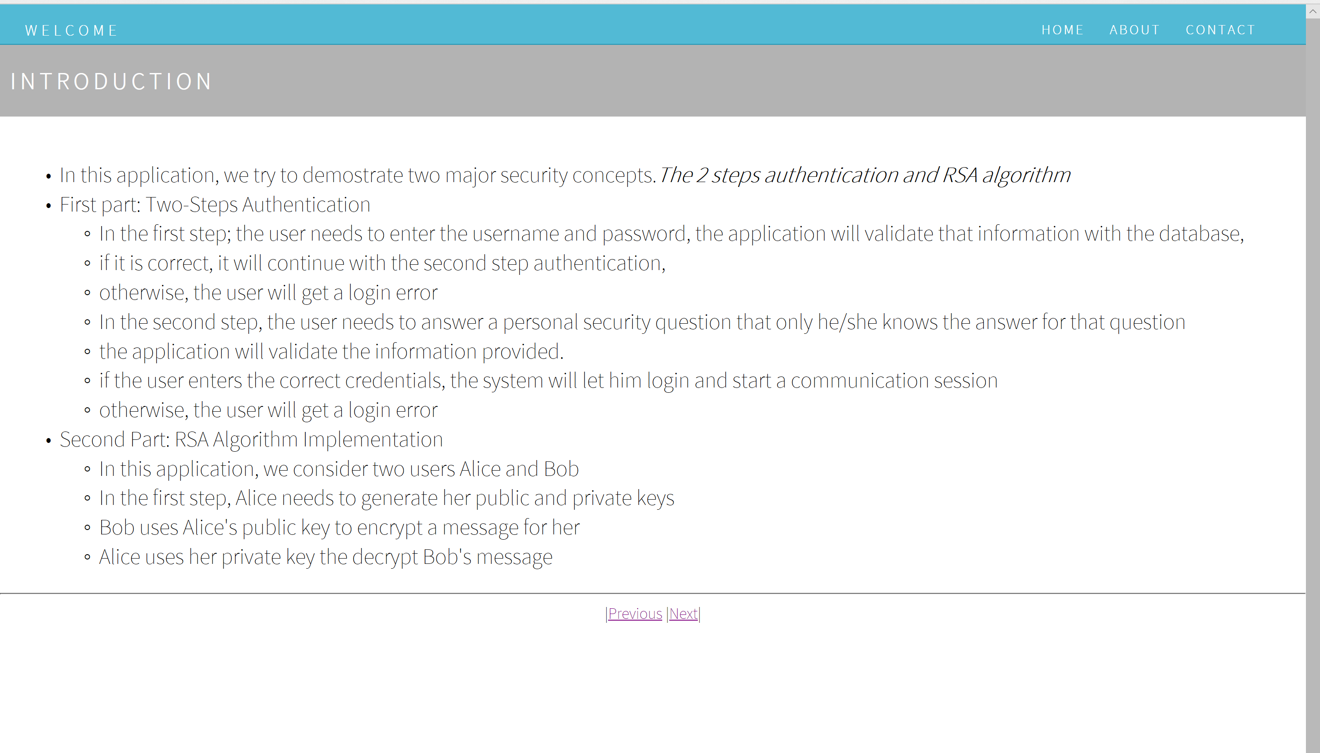
Introduction Page (introduction.html)
This page describes our application and explains the
two major security concepts used.

Slide 5
Two Steps Authentication: First Step
LOGIN PAGE (index.html): The purpose of Login Page is to validate if the user exists by checking the information provided with the database.
New User: If there is a new user, he needs to sign up by clicking on the Sign Up button which leads him to Sign Up page (CreateUser.html)
Existed User: The user needs to enter his user name and password. The application will validate that information with the data base:
If the information is correct: it will continue with the second step authentication (questionVerification.html)
If it is not correct: the user will get a login error.

Slide 6
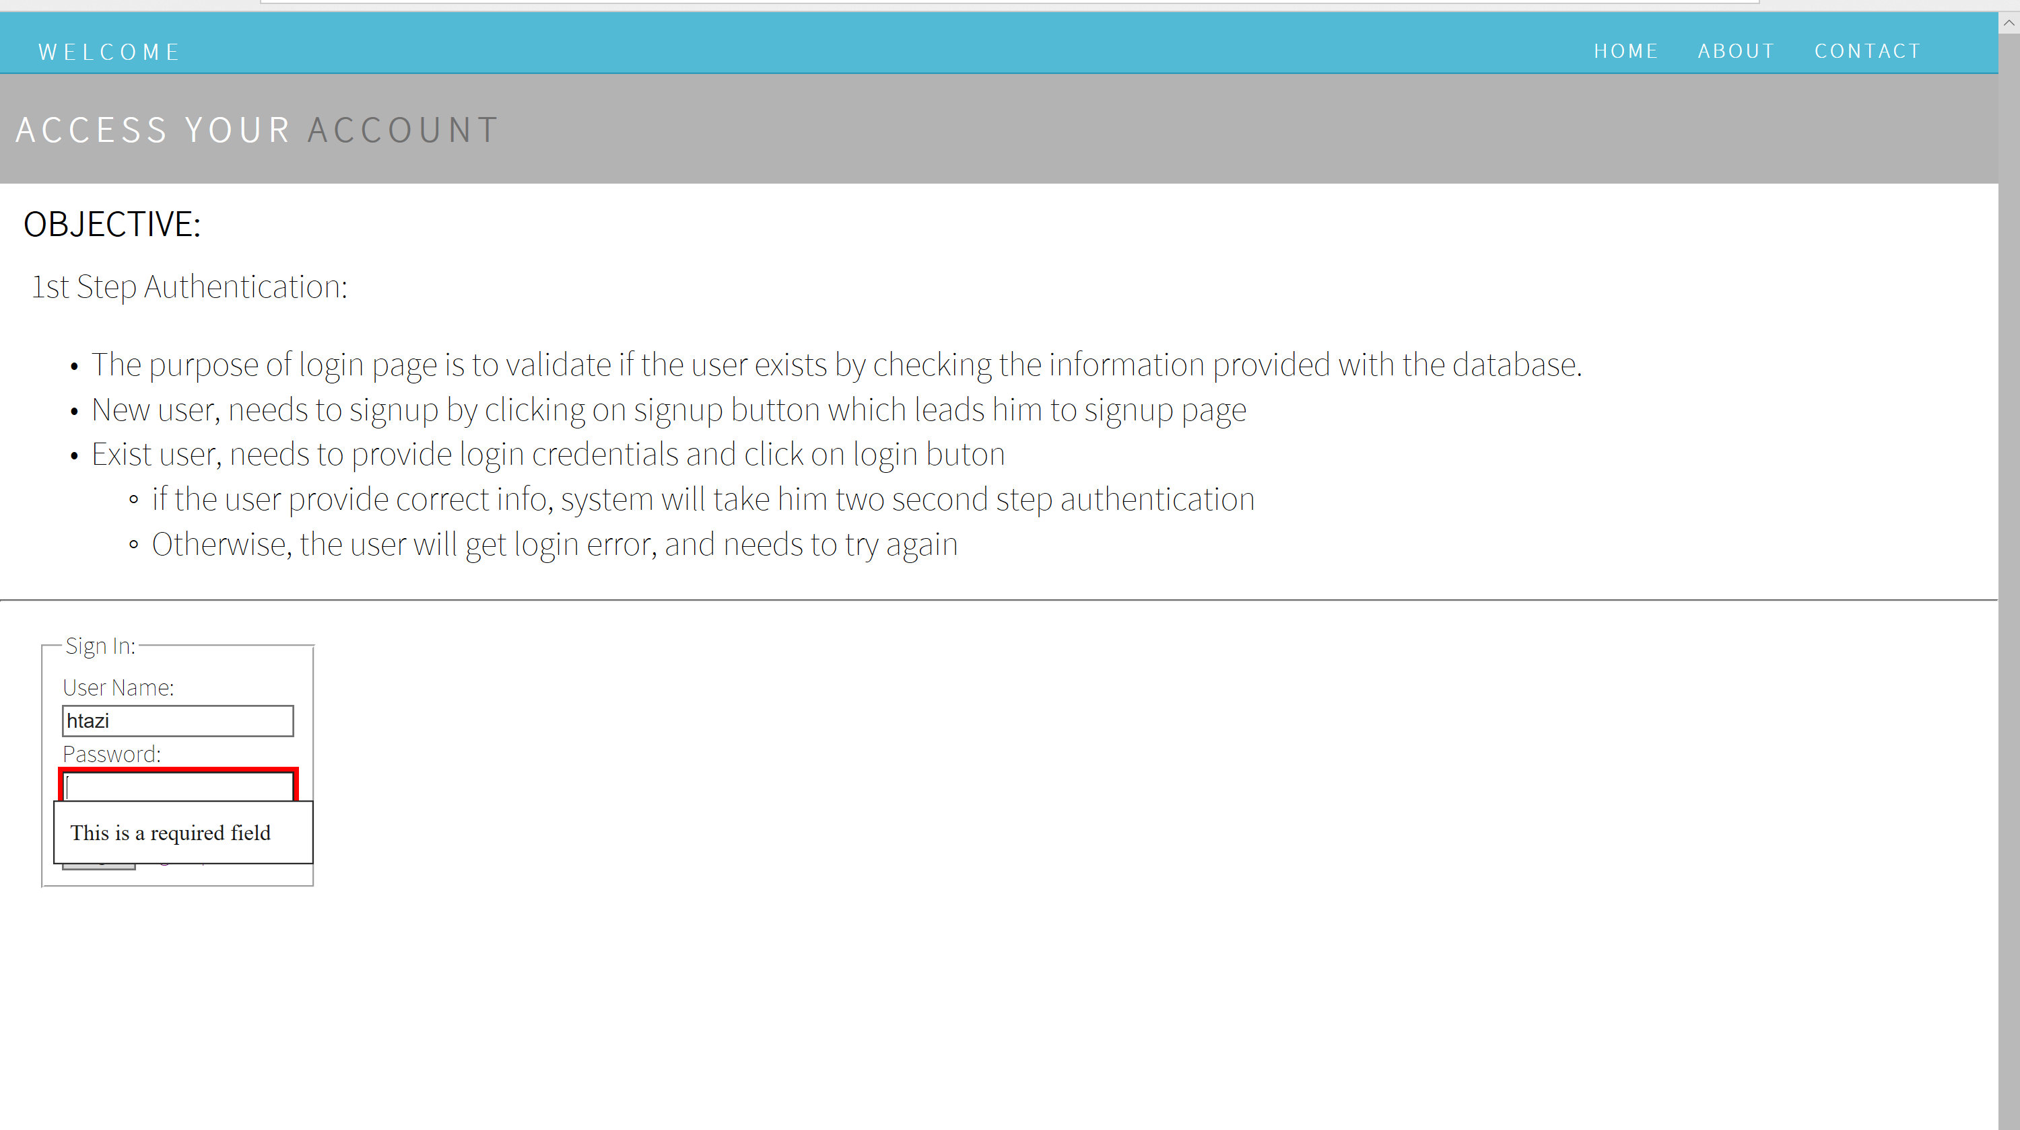
Home Page (index.html)
this page has the User Name and Password text fields as required.

Slide 7
Creating a New User
(CreateUser.html): In this page, the user will be able to create a new account to access into the system, to complete this purpose, will be have to fill out the sign up form.
For First Name and Last Name, the user is allowed to only use character, no numbers or symbols.
After the user enters a password, it will be stored as hash in data base
The user needs to answer three security questions.
After clicking the submit button, the system will take the user back into the login page (index.html).

Slide 8
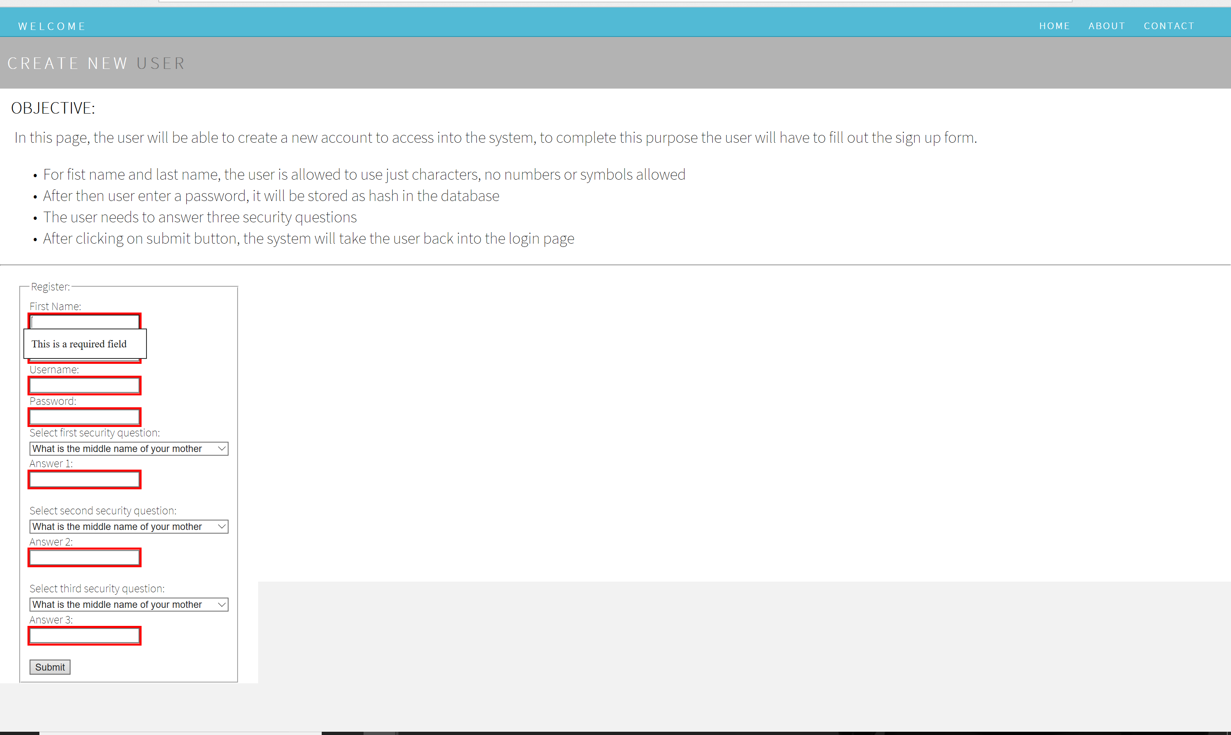
CreateUser.html
In this page, all the text fields are required

Slide 9
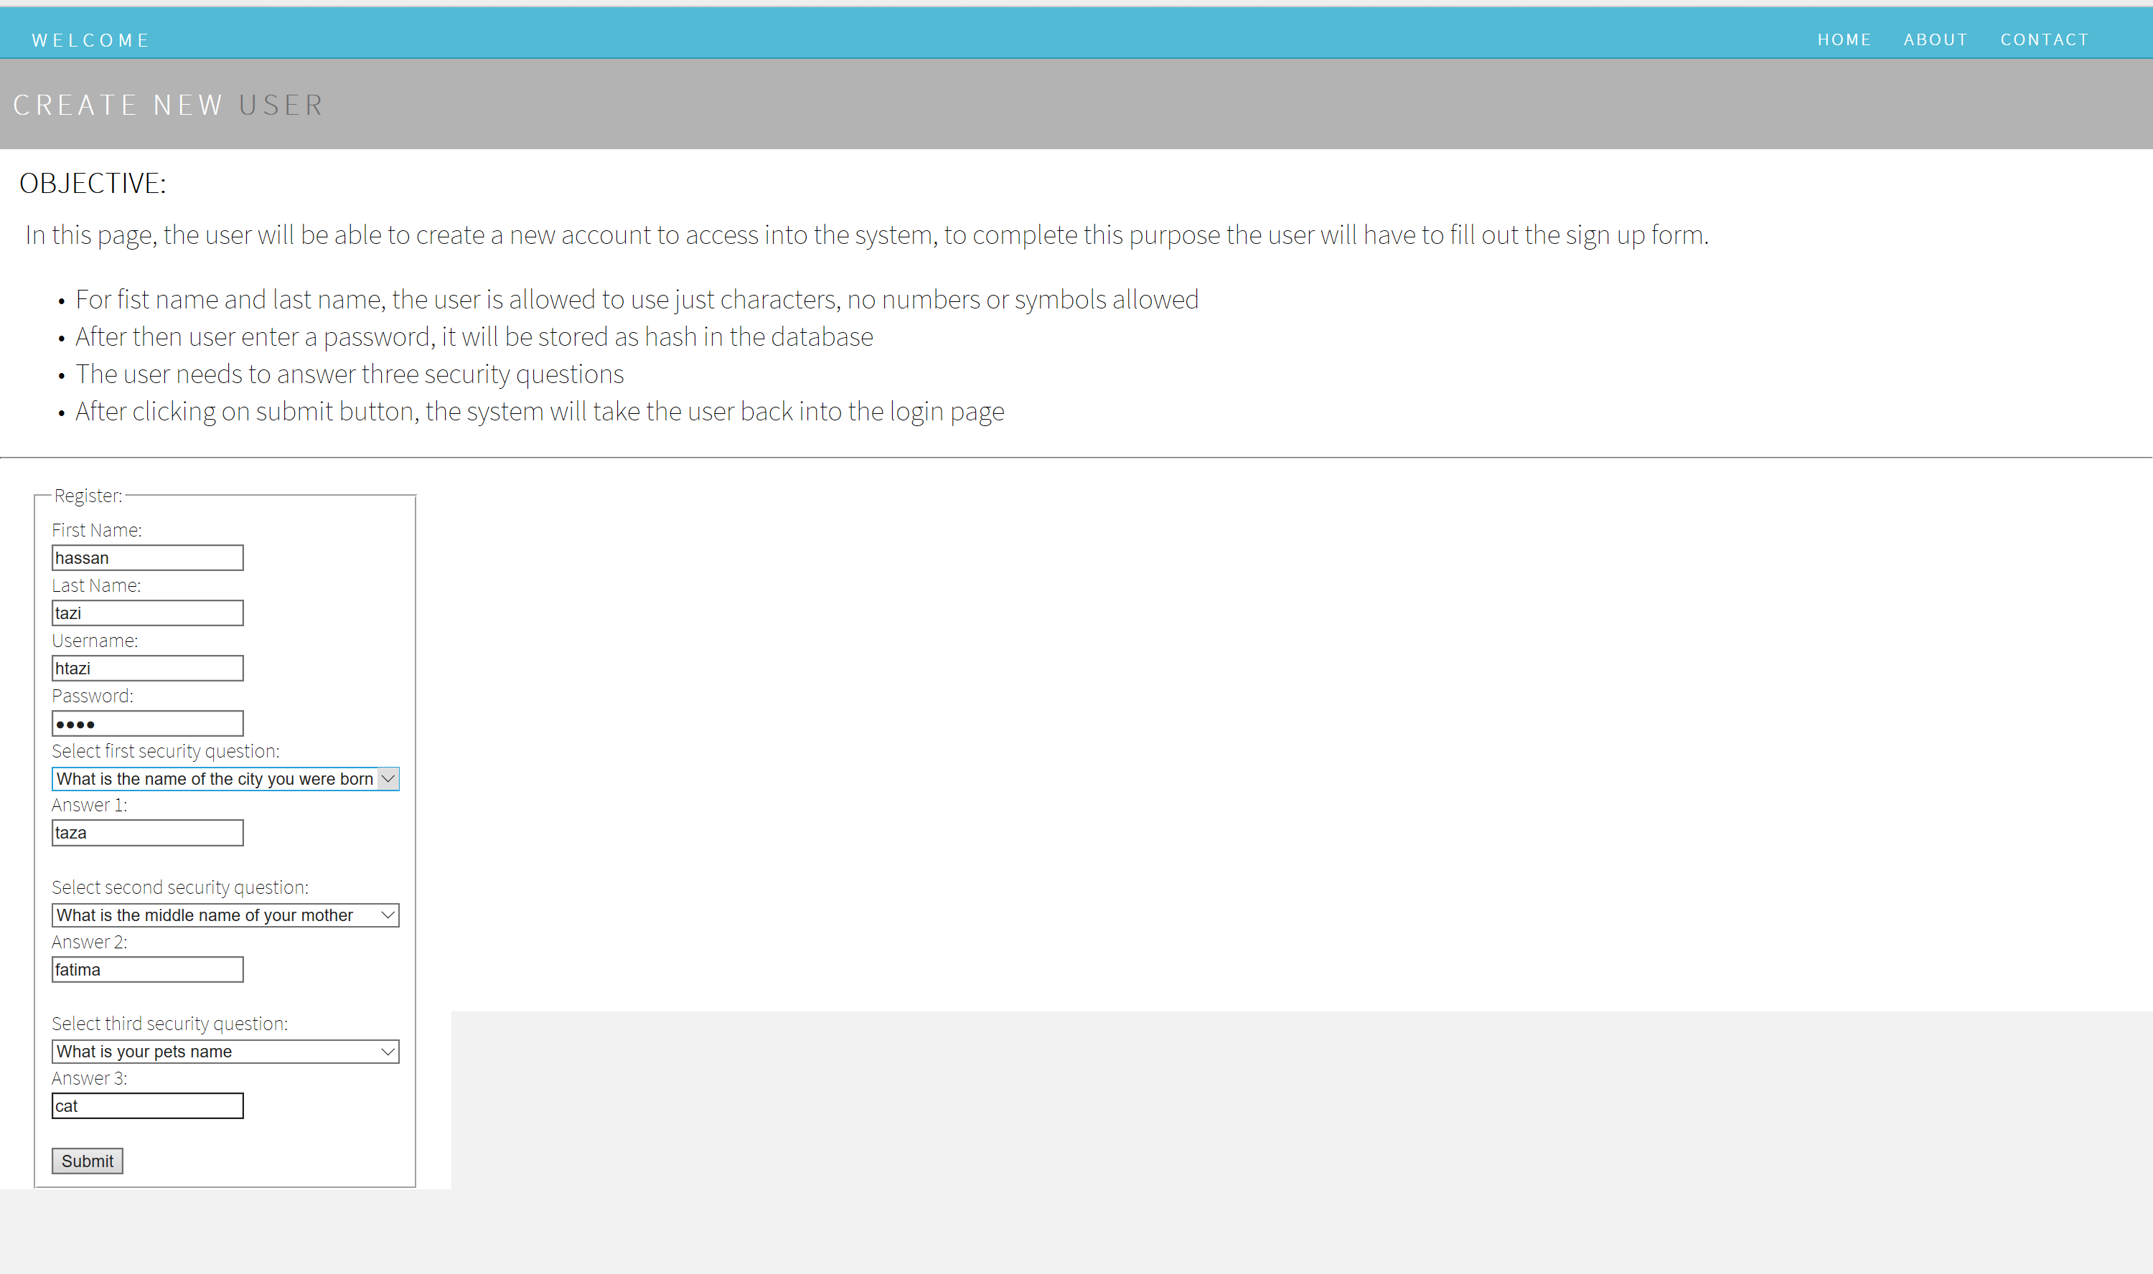
CreateUser.html

Slide 10
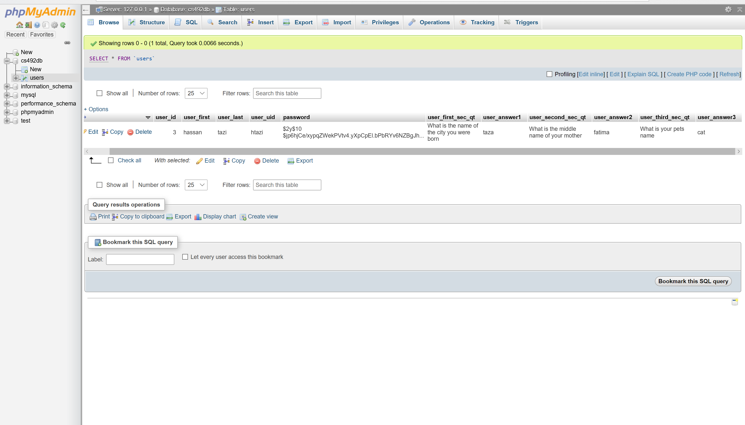
Data Base
The password is stored as hash

Slide 11
Existed User: Second Step authentication
After the user enters a valid user name and password, the system will lead him to the questionVerification.html
In this second Step Authentication, the user needs to answer a personal security question that only she/he knows.
If the information is correct: the system will let him login and start a communication session (RSA.html)
If it is not correct: the user will get a login error.

Slide 12
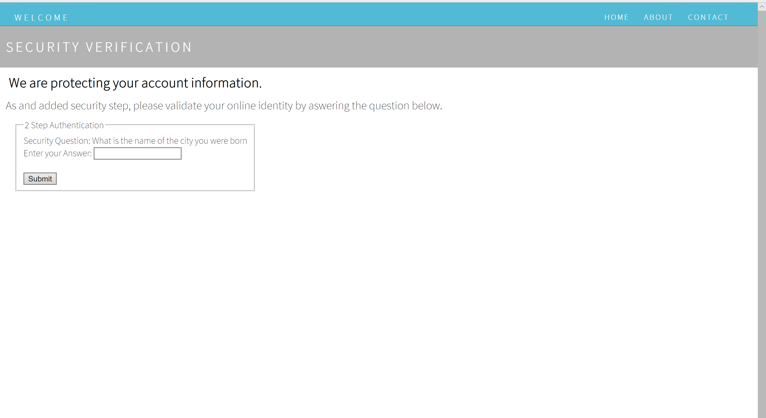
Second Step authentication questionVerification.html

Slide 13
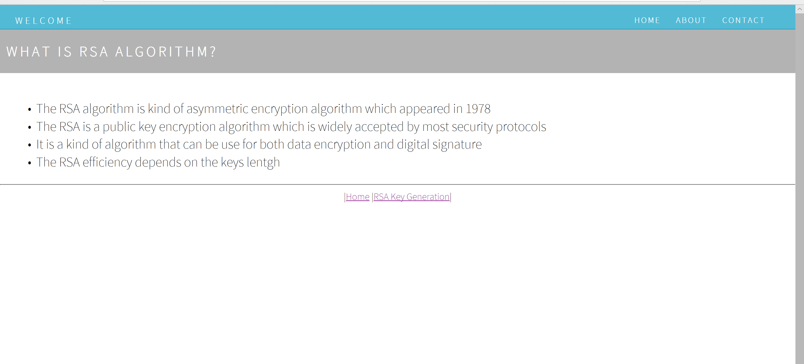
RSA.html
This page gives the user information about What the RSA Algorithm is.

Slide 14
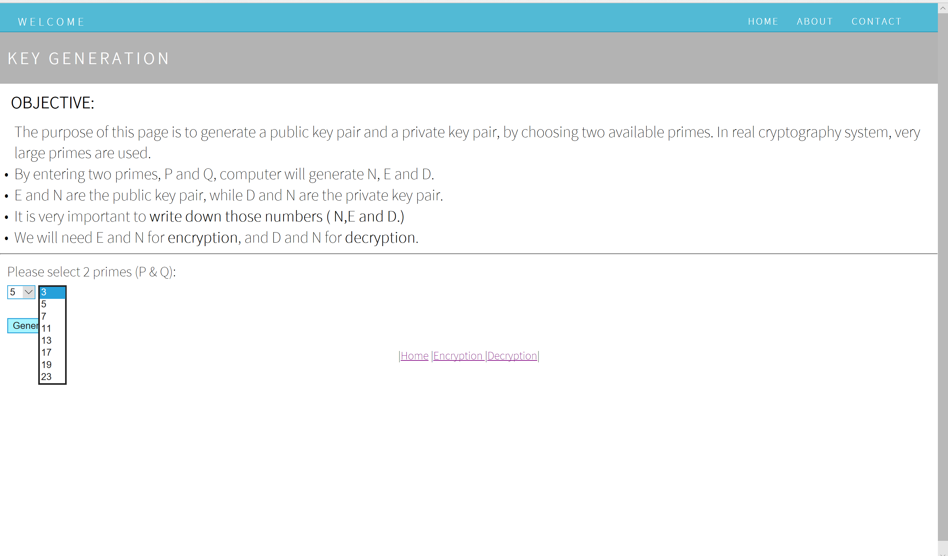
Key Generation Page (KeyGeneration.html)
In this first step, Alice needs to generate her public key by choosing two available primes numbers that will be use to compute N, E and D.

Slide 15
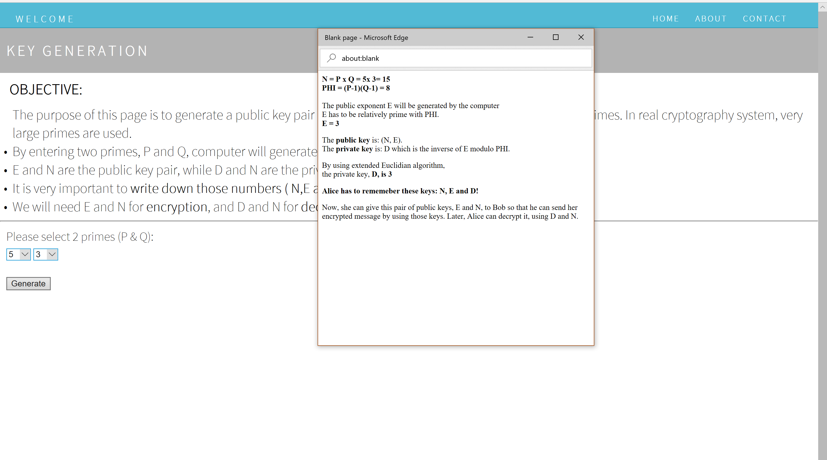
KeyGeneration.html
After choosing 2 primes number and clicking the Generate button,
this pop-up will be shown

Slide 16
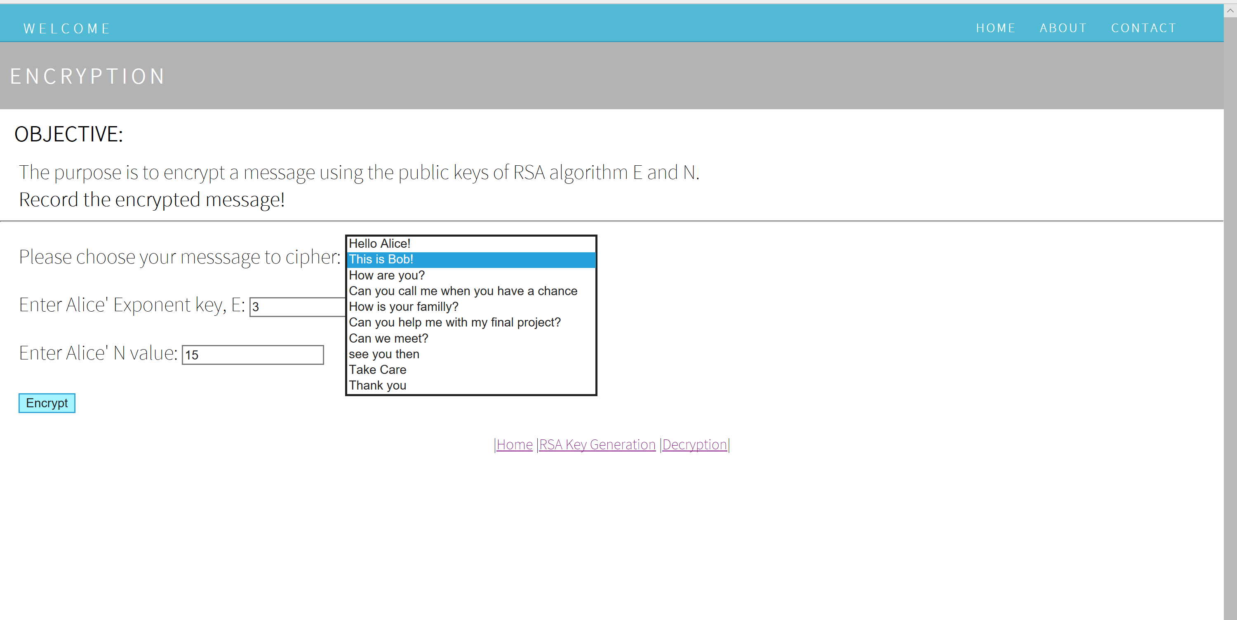
Encryption (Encryption.html)
In this case Bob, needs to encrypt the message he wants to send to Alice.
Bob uses Alice’s private key to encrypt the message for her.

Slide 17
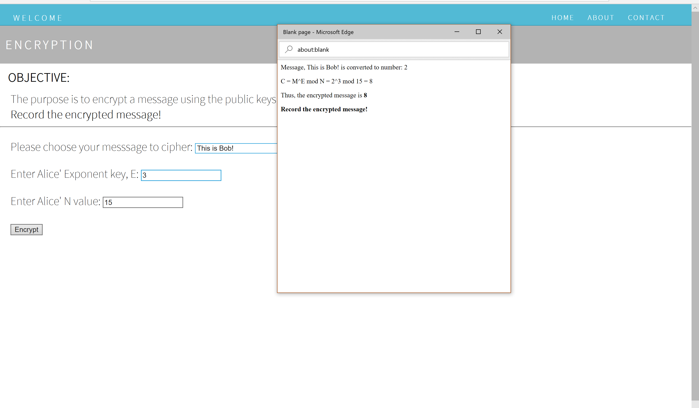
Encryption.html
After entering E and N and clicking the Encrypt button,
this pop-up will be shown

Slide 18
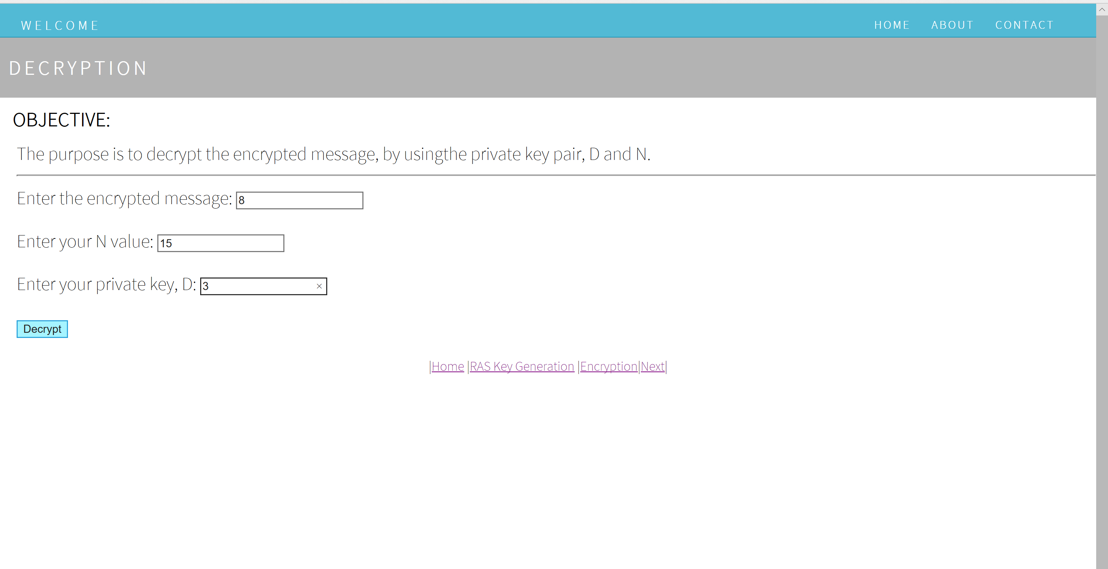
Decryption (Decryption.html)
In this page Alice uses her Private Key to decrypt Bob’s message.

Slide 19
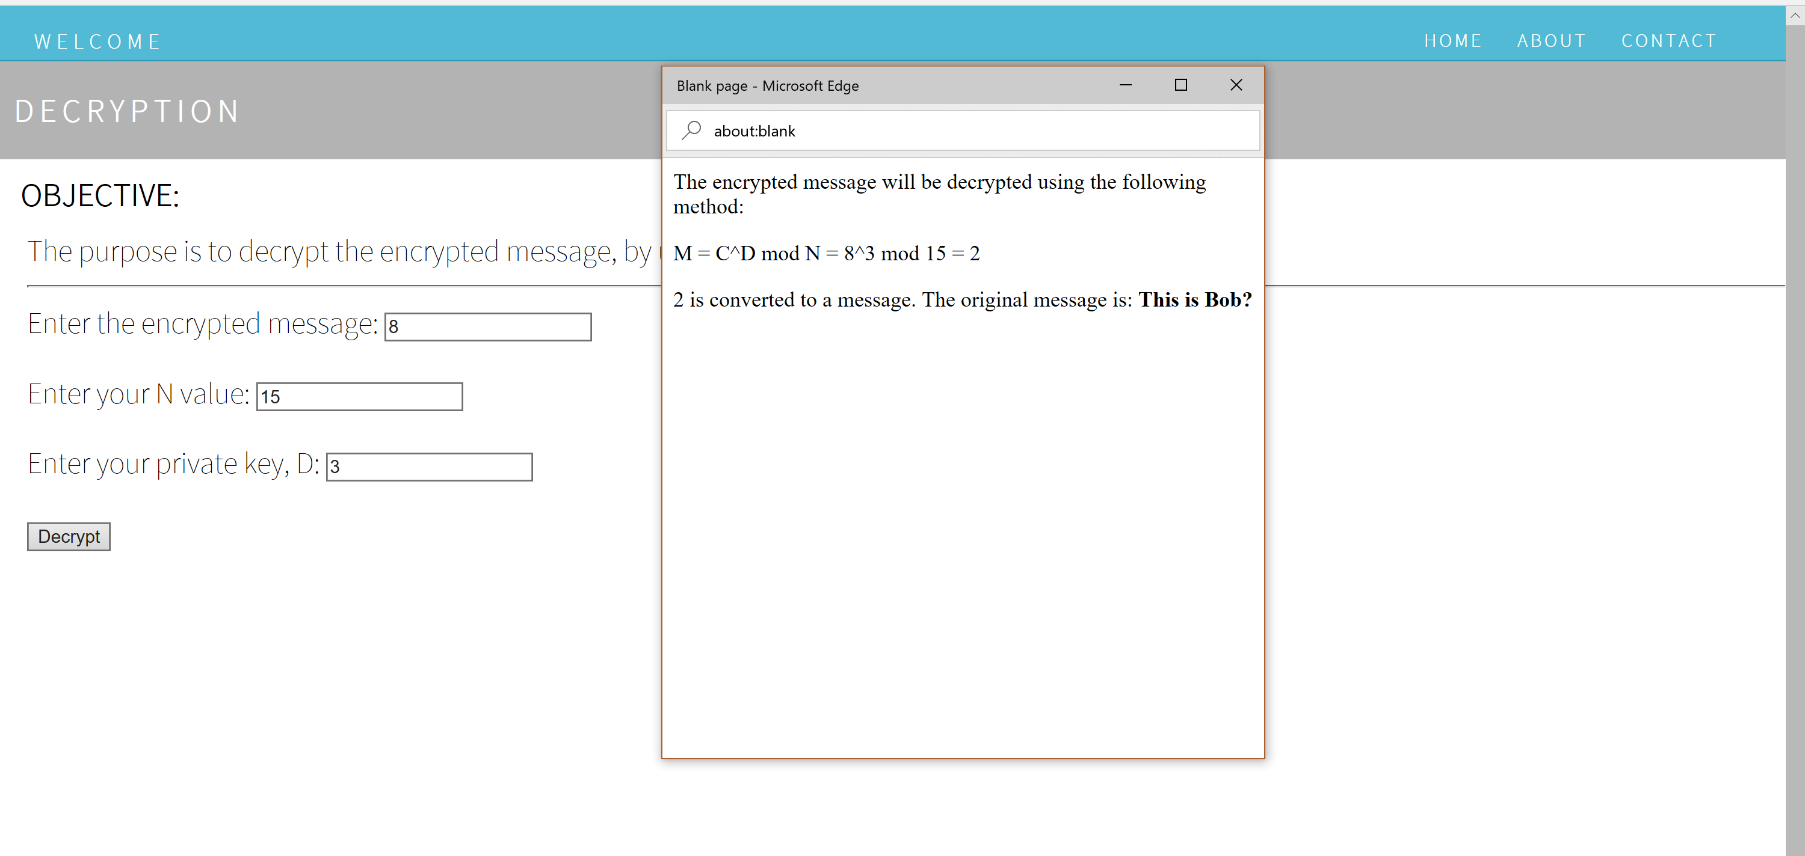
Decryption.html
After entering the encrypted message, the value of N and the private key D,
and clicking the Decrypt button, the encrypted message will be shown

Slide 20
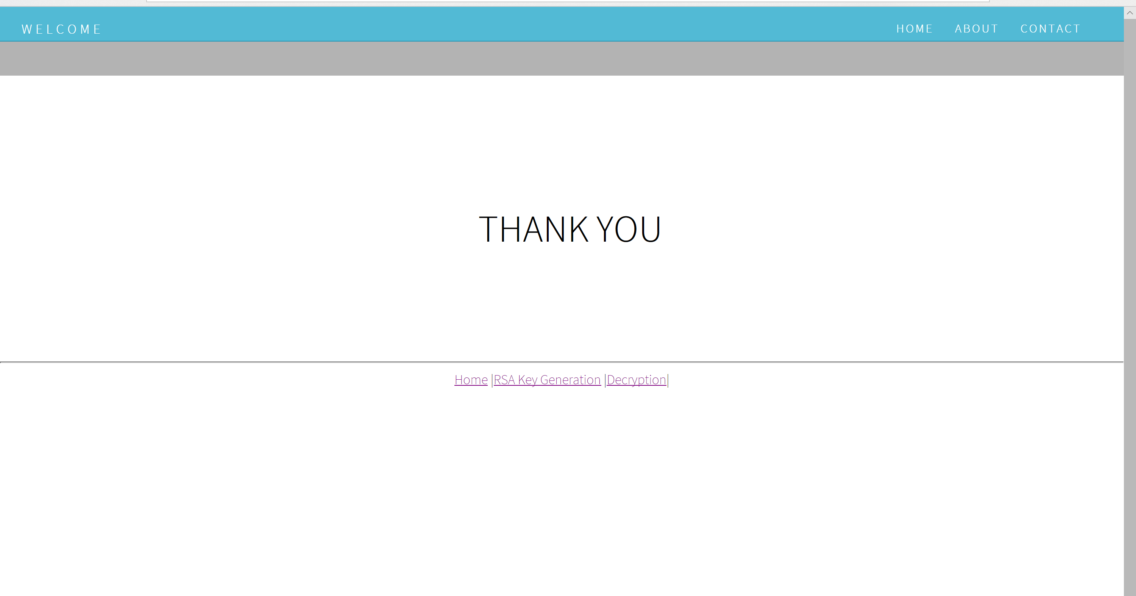
Conclusion (conclusion.html)
End of the application.

